Slide 1
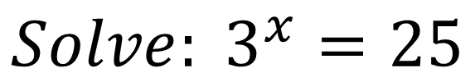
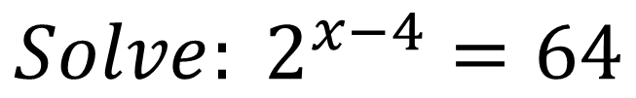
Bell Work
$$Solve: 2^{x−4}=64$$
$$Solve: 3^{x}=25$$

Slide 2
Pre-calc trig
Day 24

Slide 3
3.1 Exponential Functions and Their Graphs 3.2 Logarithmic Functions and Their Graphs 3.3 Properties of Logarithms
Objective:
Evaluate exponential functions with base a (and base e) and use exponential functions to model real-life problems
Evaluate logarithmic functions (with and without calculators/properties)

Slide 4
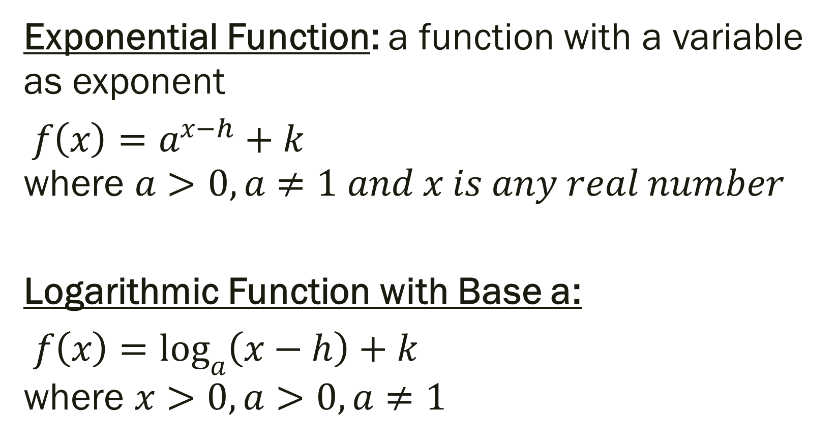
Exponential and Logarithmic Functions
Exponential Function: a function with a variable as exponent
$f\left(x\right)=a^{x−h}+k$ where $a>0, a≠1 and x is any real number$
Logarithmic Function with Base a:
$f\left(x\right)=\log_{a}\left(x−h\right)+k$ where $x>0, a>0, a≠1$

Slide 5
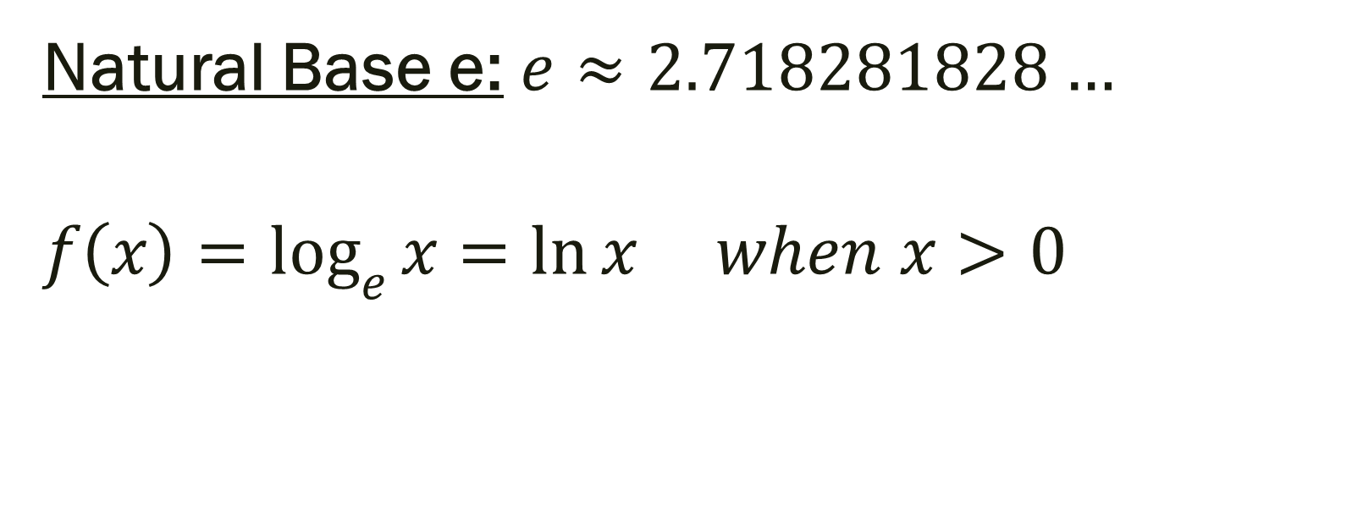
Natural Logarithmic Function:
Natural Base e: $e≈2.718281828…$
$$f\left(x\right)=\log_{e}{x}=\ln{x when x>0}$$

Slide 6
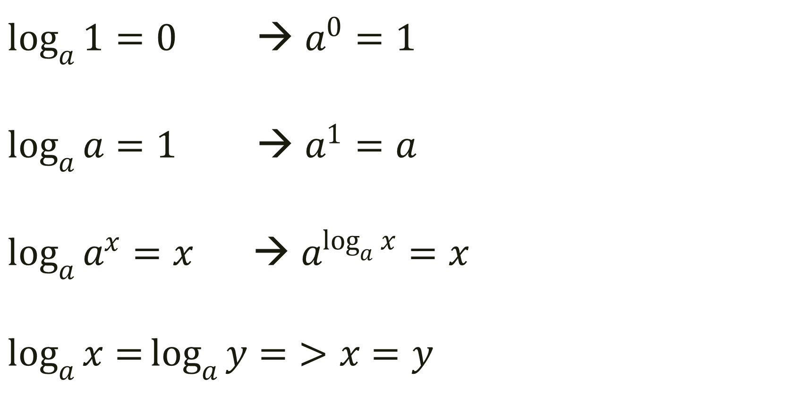
Properties of Logarithms
$\log_{a}{1=0}$ → $a^{0}=1$
$\log_{a}{a=1}$ → $a^{1}=a$
$\log_{a}{a^{x}=x}$ → $a^{\log_{a}{x}}=x$
$$\log_{a}{x=}\log_{a}{y=}>x=y$$

Slide 7
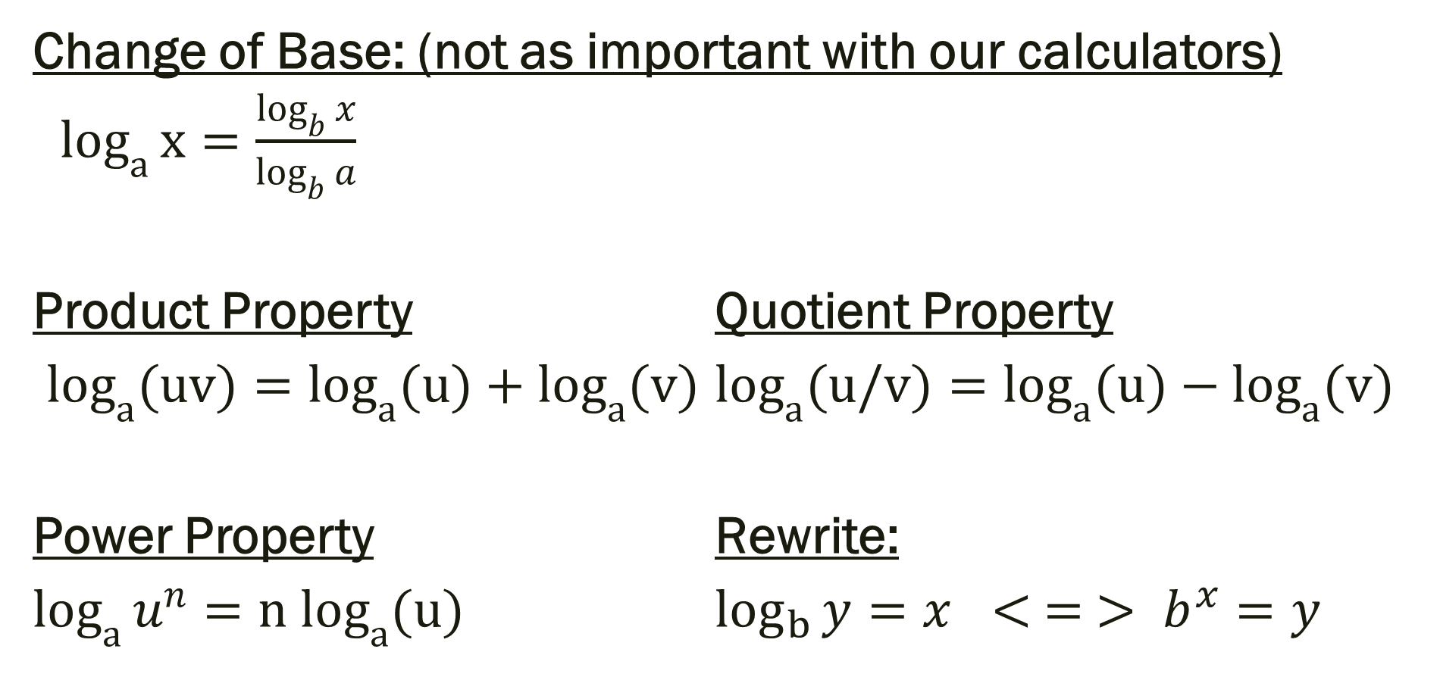
More Properties
Change of Base: (not as important with our calculators)
$\log_{a}{x}=\frac{\log_{b}{x}}{\log_{b}{a}}$
Product Property Quotient Property
$\log_{a}{(uv)}=\log_{a}{(u)}+\log_{a}{(v)}$ $\log_{a}{(u/v)}=\log_{a}{(u)}−\log_{a}{(v)}$
Power Property Rewrite:
$\log_{a}{u^{n}}={n log}_{a}{(u)}$ $\log_{b}{y}=x < = > b^{x}=y$

Slide 8
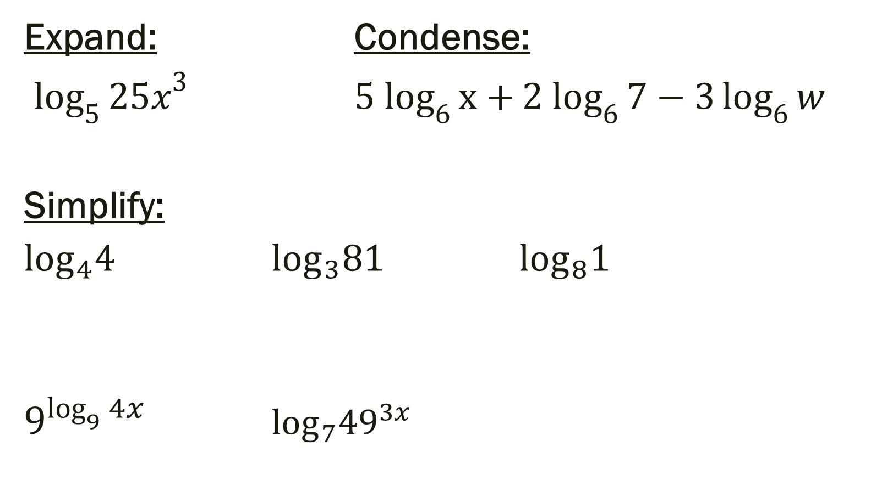
Examples
Expand: Condense:
$\log_{5}{{25x}^{3}}$ ${5 log}_{6}{x+}{2 log}_{6}{7−3}\log_{6}{w}$
Simplify:
$\log_{4}4$ $\log_{3}81$ $\log_{8}1$
$9^{\log_{9}{4x}}$ $\log_{7}49^{3x}$

Slide 9

Rewrite: From log to exponential or exponential log
$$\log_{2}{8}=3$$
$$5^{3}=125$$

Slide 10
For Next Time…
Page 224 # 7, 31, 51, 53, 55, 72
Page 234 # 7, 9, 15, 17, 19, 23, 25, 27, 53, 67, 85, 93
Page 241 # 19, 21, 29, 31, 33, 45, 47, 49, 67, 69

